Slide 1
Digital Maps and Mapping
#DigiMapTU
Today’s Goal:
Learn to distinguish between Reference and Thematic Maps and between Static and Dynamic Maps.
Clinton Davis
Temple University
11 November 2014
Notes:
Welcome students to class.
Ask them to sit and listen

Slide 2
Outline for today’s class:
#DigiMapTU
Introduction (5 min)
Brainstorming Maps (10 min)
Lecture (10 min)
Reference vs. Thematic Maps
Static vs. Dynamic Maps
Map Classification Exercise (10 min)
Q&A (5 min)
Homework assignment (5 min)
Notes:
Explain the layout for the day’s course and the loose time frame for each portion of the class session

Slide 3
Introduction
#DigiMapTU
This class is Intro. to Digital Maps and Mapping
If this isn’t your class feel free to leave or stay and check it out
Any registration questions, see me after class
The twitter #hashtag for this class is #DigiMapTU
twitter responses and engagement are encouraged
so are verbal responses and engagement =)
Urgent questions or clarifications will be addressed immediately
less urgent will be addressed during Q&A at the end of the session
All materials are also available online
Notes:
Since it is the second week of classes, remind students of the course.
Ask for registration concerns to be raised individually after class.
Introduce the twitter hashtag. Will be used throughout the semester.
Tell students that all materials are also available online, so they needn’t write everything down unless it’s helpful.
The link is in the syllabus and they’ll be receiving an e-mail with it as well.

Slide 4
Brainstorming Maps
#DigiMapTU
List some maps that you’ve used, seen, heard of, etc.
I will list them on the board as you respond verbally, or submit them to the twitter hashtag.
Notes:
Open with interactive activity to get students involved. This list will be used later in the lesson.
Ask students to brainstorm examples of maps. Prompt as necessary to fill out all four types to be discussed later in the session.
Fill up board. Be sure to encourage twitter submissions to set the stage for future use.

Slide 5
Lecture - Slide 1 of 4
#DigiMapTU
Reference Maps
Used as a reference
Contains many kinds of information
Analogous to reference books; Dictionaries, Encyclopedias, etc.
Thematic Maps
Focuses on a Theme or tells a story
Often contains few different kinds of info
Analogous to articles or books about a certain subject
Notes:
Explain the core distinction between reference and thematic maps. This distinction will be important to framing our discussion of map types, designs, and content for the rest of the semester. It is important that the students understand this now to facilitate those conversations.

Slide 6
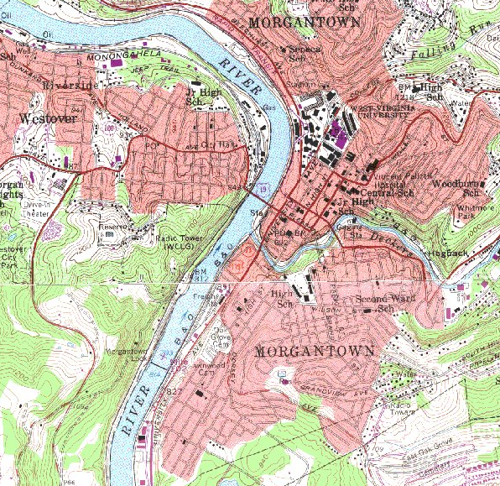
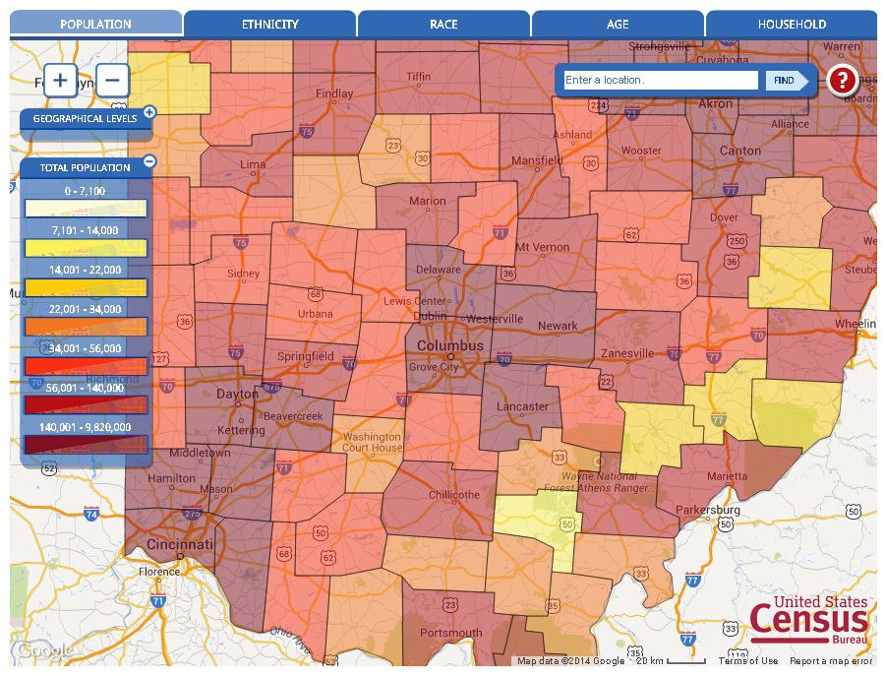
Lecture - Slide 2 of 4
#DigiMapTU
Reference Maps
Ex: USGS Topographic Maps
Thematic Maps
Ex: Census Population Map
Notes:
Provide common examples: USGS quads are Reference Maps, Map of the population of various states is Thematic

Slide 7
Lecture - Slide 3 of 4
#DigiMapTU
Static Maps
= Fixed; stationary
Does not respond to user interactions
Remains as it is unless a new version is created/released
Can be paper or electronic
Dynamic Maps
= Constant change
Responds to user interaction
Can be updated constantly and/or automatically
Mostly electronic (often web or mobile)
Notes:
Explain the core distinction between static and dynamic maps.
The first half of the semester will be focussed on static maps, while the second half will look at dynamic maps.

Slide 8
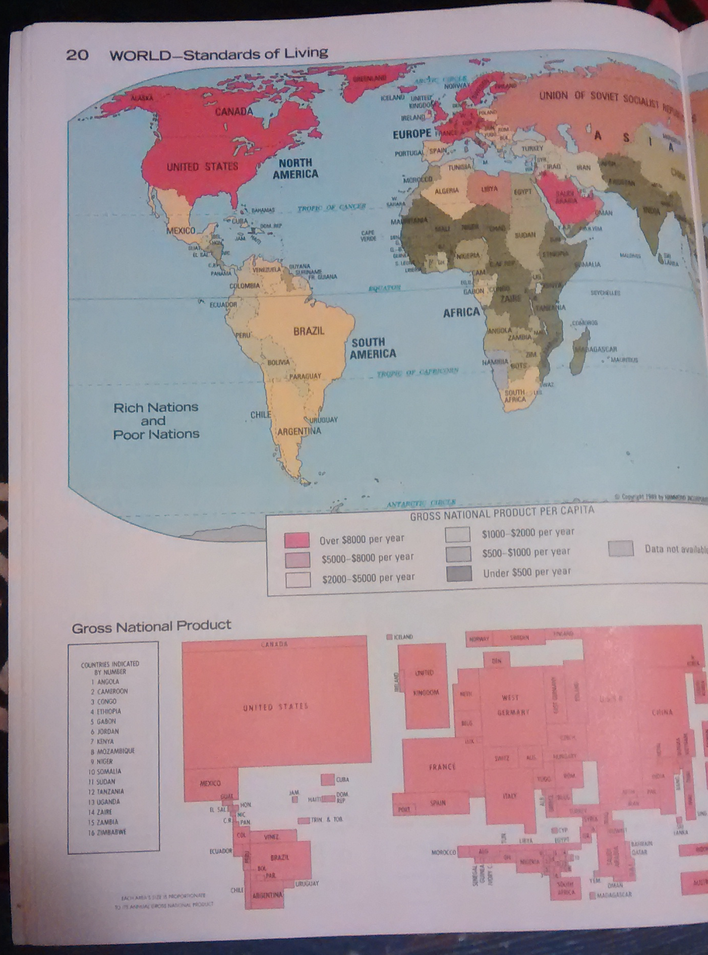
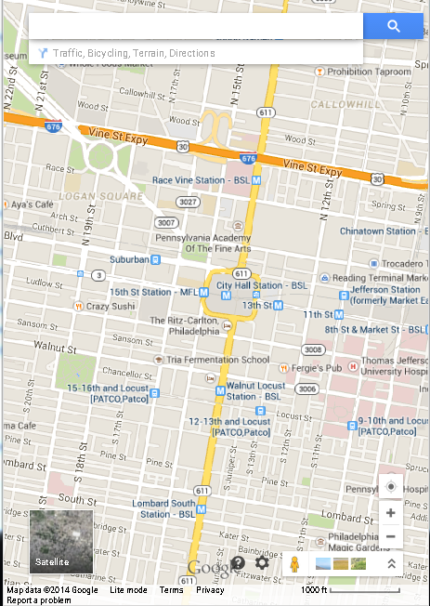
Lecture - Slide 4 of 4
#DigiMapTU
Static Maps
Ex: A map in a paper atlas
Dynamic Maps
Ex: Google Maps
Notes:
Examples of static (a page in a paper atlas) and dynamic (google maps)

Slide 9
Map Classification Exercise
#DigiMapTU
Classify the maps from our brainstorming into
Dynamic
Reference
Thematic
Static
Notes:
draw axes on board and list maps from brainstorming in each quadrant as appropriate until students get it or several of each quad have been done.

Slide 10
Questions and Answers
#DigiMapTU
Are you confident on the distinctions between:
Reference and Thematic Maps
and
Static and Dynamic Maps ?
If you are unclear, or have other questions, please ask them now, tweet them, or come see me during my office hours.
Notes:
Solicit questions and clarifications. Respond both to verbal questions and questions posted throughout the class session on twitter.

Slide 11
Homework Assignment: Due Next Class
(assignment will be posted online)
#DigiMapTU
Find a map (online or paper)
Record the source information and a screenshot or picture of the map.
Is it a Reference or Thematic Map?
Is it Dynamic or Static?
What is one way it could be used? (if Reference)
What is the theme? (if Thematic)
Notes:
Introduce the homework assignment.

